Slide 1
Differentiated Education Plan Meeting
Cotswold
Fall 2017

Slide 2
Our Meeting Goals:
Explore how the needs of gifted and high-ability learners are met through the Catalyst Model.
Experience snapshots of gifted curriculum and resources and how we are integrating them into instruction at Cotswold.
Review the Differentiated Education Plan for 3rd-5th graders.

Slide 3
TD Catalyst Teacher Responsibilities
Provides professional development for staff on instructional best practices in gifted education
Models best teaching practices
Utilizes collaboration and consultation skills to implement the TD Catalyst Model
Provides assignments, activities, contracts, and other learning opportunities to assist teachers in differentiating curriculum

Slide 4
TD Catalyst Model
An organizational delivery model in which the TD teacher and the classroom teacher(s) work collaboratively to meet the needs of gifted and high ability learners.

Slide 5
The TD Catalyst Model….
Joint effort by TD Catalyst Teachers and Classroom Teachers
Allows classroom and TD teacher to design & implement frequent differentiated educational experiences for gifted and high-ability students
Includes co-teaching whole group mini-lessons, small group lessons, individual conferring
Modeling of higher level strategies

Slide 6
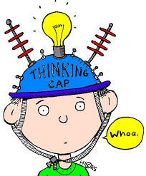
Our TD Program
Focus on quality not quantity
Quality of thinking, not more of the same
High expectations all day, every day
Complex, challenging & real world
Collaborative, integrated, and inclusive

Slide 7
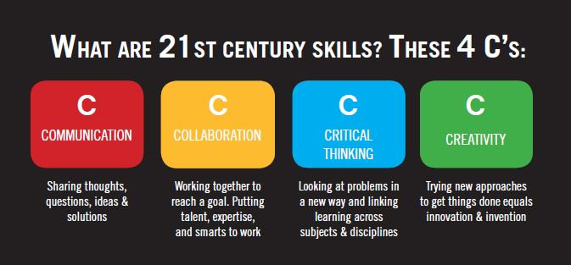

Slide 8
Who are the Collaborators?
TD Catalyst Teachers
Classroom Teachers
Administrators
Academic Facilitators
Parents & Community Members

Slide 10
Benefits of Catalyst Model
Gifted education and general education are related, connected, and integrated.
The pace of learning is enhanced.
High achieving students receive more challenging tasks within the classroom.
Classroom and TD Teachers work together to maximize student learning.

Slide 11
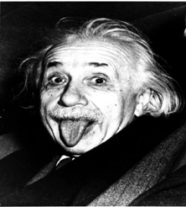
The Catalyst Model recognizes that...
Gifted education is NOT an add-on for 90 minutes a week because gifted learners are gifted all the time.

Slide 12
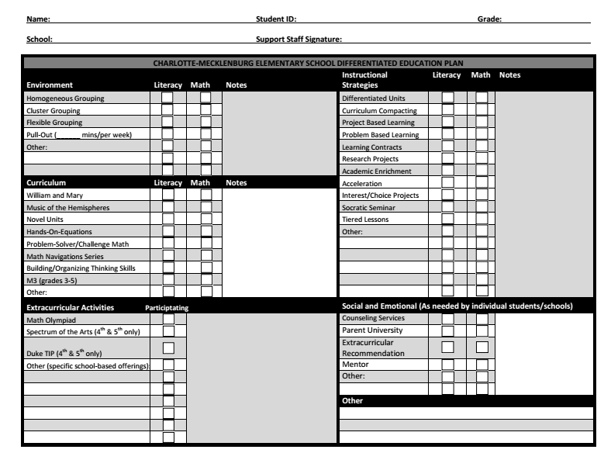
Differentiated Education Plan

Slide 13
Environment

Slide 14
Our Learning Environment
Flexible Grouping Model
3rd Grade:
McBride/Doyle/Meyers- Literacy 4 days a week 10:30 -11:30
Hammack- Math 2 days a week (Wednesday and Thursday) 3:15-4:00
4th Grade:
Kinnamon/Graney- Literacy 5 days a week 1:00-2:00
Kinnamon- Math Thursday 9:30-10:00
5th Grade:
Johnson/Kennedy- Literacy 4 days a week 2:00-2:45
Johnson- Math Friday 10:30-11:30
Google Classroom is used as a Blended Leanring tool to assist students throughout their learning day.

Slide 15
Curriculum

Slide 16
Our Curriculum
Differentiated Instruction
Interest/Choice Projects
Learning Contracts
Tailored small group instruction
Curriculum compacting
Greater depth of exploration
Subject integration
IB Units of Study
Standard curriculum extensively supplemented with research-based gifted resources & strategies
William & Mary Language Arts Units
Jacob’s Ladder
Project M3 Math
My Webstie with links to these pieces of Curriculum

Slide 17
Instructional Strategies

Slide 18
What Types of Strategies are Used?
Problem Based Learning
Paideia Seminars
Learning Contracts
Interest/Choice Boards
Integrated Projects
Tiered Lessons
Curriculum Compacting
Independent Studies
...and so much more!

Slide 19
Extracurricular
Activities

Slide 20
Clubs
OM
Science Olympiads
Math Olympiads
Girls on the Run
Let Me Run
Robotics

Slide 21
Social and Emotional

Slide 22
Understanding Gifted Learners
Cognitive Skills | Cognitive Challenges
Power of critical thinking; skepticism | Critical attitude toward others; self-criticism
Skills in abstraction, synthesis, concept formation; Interest in inductive learning | Looks beyond literal explanations; omits obvious details
Retains knowledge easily | Dislike for routine drill
Verbal proficiency; large vocabulary | Seeks high levels of verbal interaction and engagement;
Intellectual curiosity; inquisitive thinking | Maintaining focus on a goal

Slide 23
Understanding Gifted Learners
Creativity Skills | Creativity Challenges
Creative and inventive | Creativity absorbs focus and effort; need to invent for oneself
Wide range of interests; flexible | Indecision; overwhelmed by options
Self-acceptance; Socially non-conforming | Resists social conformity
Imaginative; values aesthetics | Meeting daily schedules of family and school structure is challenging; Needs time; can’t be rushed

Slide 24
Understanding Gifted Learners
Affective/Behavioral Skills | Affective/Behavioral Challenges
Emotional depth and intensity; Intuitive; empathy for others | Emotionally sensitive; need for emotional support; Vulnerable; sensitive to criticism; Has world view anxiety
High expectations of self and others | Feelings of frustration; perfectionism
Heightened self-awareness | Feelings of being different
Spontaneous; enthusiastic; high energy | Frustration with inactivity; boredom;
Intense concentration | Resistance to interruption
Persistent; goal-directed behavior | Stubbornness

Slide 25
What’s a parent to do? Tips for Coping
Stay calm and listen
Accept and validate feelings
Adopt and model a growth mindset
Praise effort and perseverance
Encourage your kids to try new things
Allow kids to fail and make mistakes
Set goals
Model self-care
Schedule relaxing events
Stay in the present moment
Notes:
Staying calm and not getting frustrated as a parent is hard when your child is 5 and gets harder when they are 15. So these are the years to practice. Take your own deep breathes.
Accept that your child’s fears, worries, frustration, anger is real. Acknowledge it, name it and validate it. I’ve felt that way. I get it. I know what that is like. That’s happened to me.
Name and validate anxiety, worry, stress… Anxiety—thoughts, feelings, actions
A growth mindset is thinking of your skills as progressing, not fixed. Skills not abilities. Our brains are malleable, not set. Effort overrides limits. Not pollianna thinking. We all have a range of abilities. It’s using experiences, effort, perseverance and exposure to stretch the range of possibility.
Exposure- try new things, make mistakes, PENCIL- Human imperfection; Perfectionists Enjoy No Contentment in Life
Set small goals and celebrate
Mindfulness

Slide 26
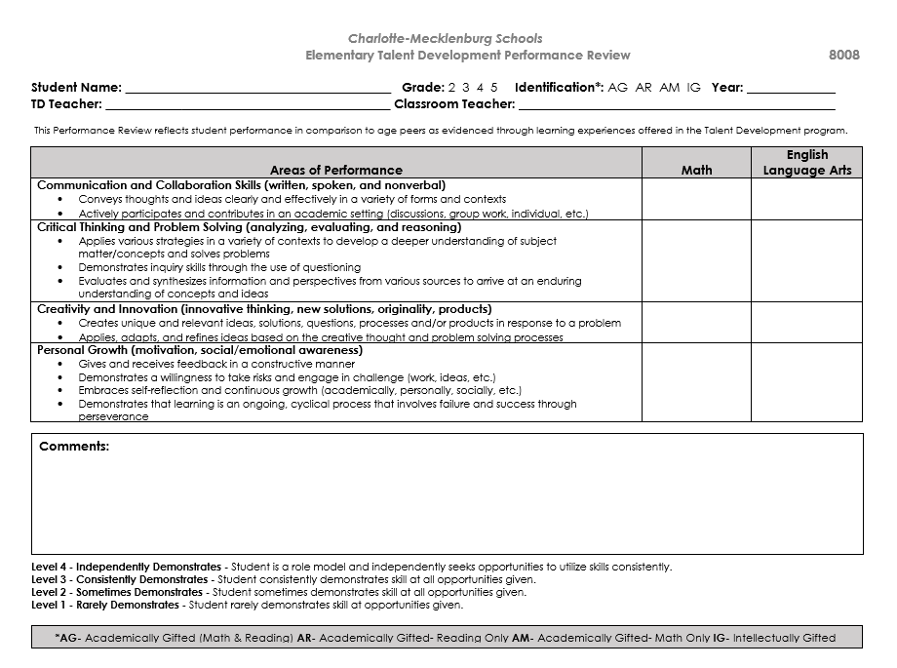
Performance Review

Slide 27
Performance Review
These come home at the end of the year with the final report card. Please be on the look for them as I do include some type of summer reading or work to do over the summer.

Slide 28
Questions?

Slide 29
Contact Information
TD Catalyst: Samantha Meyers
samantha.meyers@cms.k12.nc.us
School Phone #980-343-6720
Website:http://cotswoldtd.weebly.com/
Instagram: @tdsmeyers

